Slide 1

COVID-19 Vaccine Basics:
What Healthcare Personnel Need to Know
Presentation developed by:
CDC COVID-19 Response
Vaccine Task Force
December 2020
Notes:
Thank you for joining us today. Whether you are a doctor, a nurse, a medical assistant, a member of the check-in staff, or facilities management, you serve in a healthcare setting and are, therefore, first in line for a COVID-19 vaccine. Today, we’ll cover what we know about these vaccines and arm you with the information you need to make a decision about getting one.

Slide 2

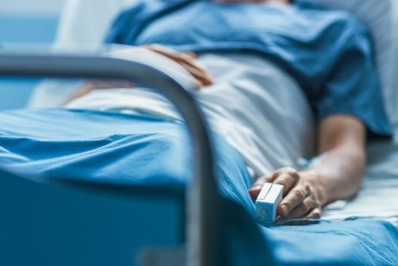
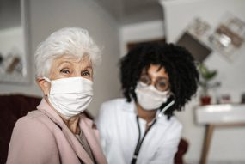
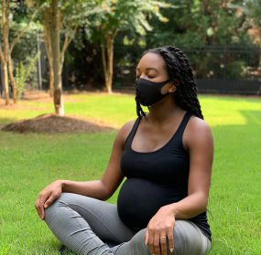
What we know about COVID-19
Infection with SARS-CoV-2, the virus that causes COVID-19, can result in a range of illnesses, from mild symptoms to severe illness and death.
We don’t know how SARS-CoV-2 will affect each person.
Some people are more likely than others to become severely ill, such as older adults (65+ years) or people with certain medical conditions.
Notes:
To begin, let’s review what we know about COVID-19. We know that infection with SARS-CoV-2, the virus that causes COVID-19, can result in a range of illnesses, from mild symptoms to severe illness and death. About 30% of persons infected with SARS-CoV-2 do not have symptoms. We can’t predict how severe any person’s illness might be. But we have learned a lot this year and we know that certain factors may increase your risk. Some people are more likely than others to become severely ill when infected, such as older adults or people with certain medical conditions, like diabetes, obesity, cancer, or heart disease.

Slide 3
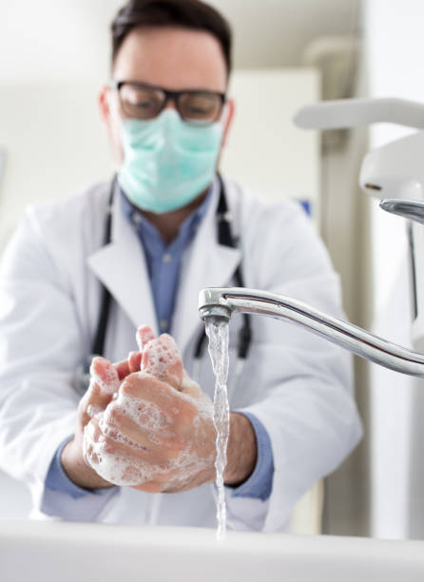
How to prevent COVID-19
Wear a mask that covers your mouth and nose.
Avoid close contact with others. Stay at least 6 feet (about 2 arms’ length) from other people.
Avoid touching your eyes, nose, and mouth with unwashed hands.
Clean and disinfect frequently touched surfaces daily.
Wash hands often with soap and water.
Use an alcohol-based hand sanitizer with at least 60% alcohol if soap and water are not available.
Notes:
We have also learned about actions we all can take to help prevent COVID-19.
Wear a mask that covers your nose and mouth. Avoid close contact with others as much as possible. Avoid touching your face--your eyes, nose, and mouth--with unwashed hands. Clean frequently touched surfaces. Wash your hands often with soap and water for at least 20 seconds. And use an alcohol-based hand sanitizer with at least 60% alcohol, if soap and water are not readily available. These are all tools in our toolbox, and the more tools we use to prevent the spread of the virus that causes COVID-19, the safer we all will be.

Slide 4
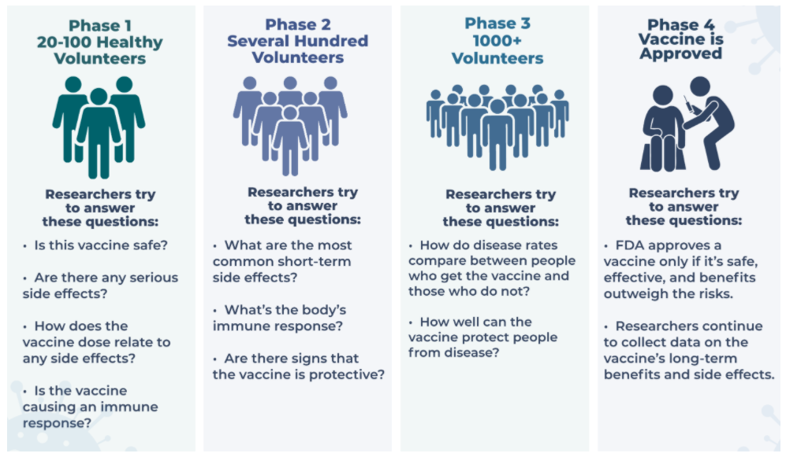
Adding new measures for prevention: COVID-19 vaccines
Multiple COVID-19 vaccines are in development, several of which are in large scale (Phase 3) trials.
FDA’s Emergency Use Authorization is a process that helps facilitate the availability and use of medicines and vaccines
during public health emergencies,
such as the current COVID-19
pandemic.
COVID-19 vaccines are being held
to the same safety standards as
all vaccines.
Understanding Clinical Trials | NHBLI (nih.gov)
Notes:
Now we are on the verge of adding more tools to our toolbox, COVID-19 vaccines. Multiple COVID-19 vaccines are in various phases of development in the United States and worldwide. The federal government is funding and coordinating the development of multiple vaccine candidates, several of which are in Phase 3 trials.
In the United States, these vaccines will be authorized using FDA’s Emergency Use Authorization or EUA. An EUA is a process that helps facilitate the availability and use of medicines and vaccines during public health emergencies, such as the current COVID-19 pandemic. The known and potential benefits of a COVID-19 vaccine must outweigh the known and potential risks of the vaccine for use in order to receive an EUA.
And I want to emphasize that COVID-19 vaccines are being held to the same safety standards as all vaccines.

Slide 5
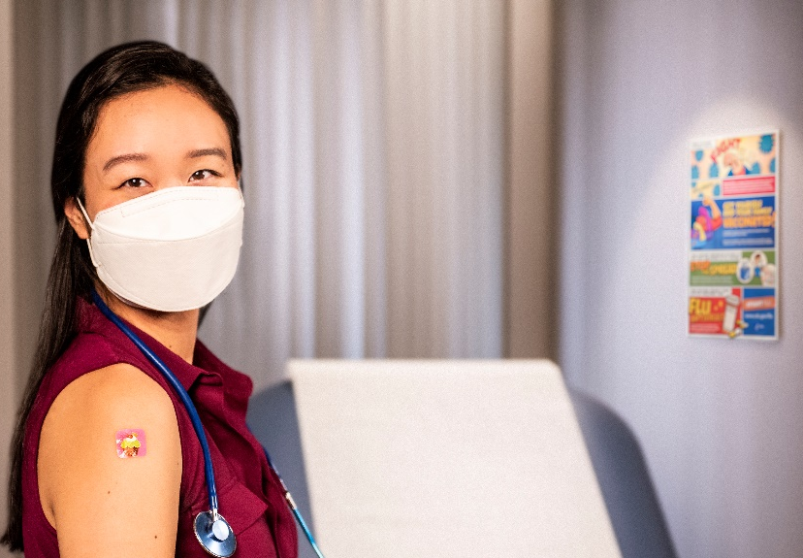
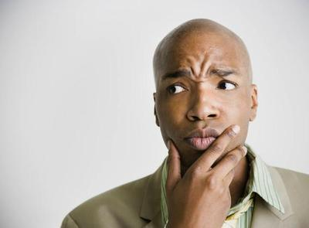
Healthcare personnel are first in line for COVID-19 vaccine
Why are you first in line?
On the front lines
High risk of exposure
Potential to transmit to others at higher risk
But . . . you might have a lot of questions.
Notes:
When vaccines are first released, there might be a limited supply and certain groups might be recommended to get a COVID-19 vaccine first. As part of the healthcare system, you are on the front lines of this pandemic and are at high risk of exposure. You can also potentially transmit the virus that causes COVID-19 to populations at higher risk for severe COVID-19 infection, including older adults and those with certain medical conditions.
As part of the healthcare system, you are in the first phase to receive a COVID-19 vaccine. We recognize that you might have a lot of questions, and we hope this presentation can help answer some of them.

Slide 6
COVID-19 vaccines expected to receive FDA Emergency Use Authorizations (EUAs)
Two vaccines expected to receive Emergency Use Authorizations (EUAs) from the FDA:
  Pfizer/BioNTech (BNT162b2): 2 doses given at least 21 days apart
  Moderna (mRNA-1273): 2 doses given at least 28 days apart
Both vaccines were tested in tens of thousands of adults from diverse backgrounds, including older adults and communities of color.
Clinical trial data show that both vaccines are safe and effective at preventing COVID-19.
It is unknown how long protection from vaccines might last.
Sources: https://www.pfizer.com/news/press-release/press-release-detail/pfizer-and-biontech-conclude-phase-3-study-covid-19-vaccine
https://investors.modernatx.com/news-releases/news-release-details/modernas-covid-19-vaccine-candidate-meets-its-primary-efficacy
Notes:
Two vaccines are first in line for Emergency Use Authorizations (EUAs) from the FDA: One produced by Pfizer and BioNTech and the other produced by Moderna.
The manufacturers reported that Phase 3 trial results demonstrated that both vaccines were approximately 95% effective at preventing COVID-19 disease. Both vaccines are administered with a 2-dose schedule, separated by a few weeks.
Both vaccines were tested in diverse adult populations, including minorities and older adults. Data from the clinical trials show that both vaccines are safe and effective at preventing COVID-19. It is currently unknown how long the protection from receiving a COVID-19 vaccine might last.

Slide 7
COVID-19 vaccine trials by the numbers
As of November 30, 2020
Pfizer/BioNTech
  43,931 enrolled
  150 clinical sites
    39 U.S. states
  Racial/ethnic distribution
    13% - Hispanic
    10% - African American
    6% - Asian
    1% - Native American
  45% ages 56-85
Moderna
  30,000 enrolled
  89 clinical sites
    32 U.S. states
  Racial/ethnic distribution
    20% - Hispanic
    10% - African American/Black
    4% - Asian
    3% - All others
  64% ages 45 and older
    39% ages 45-64
    25% ages 65+
Source: https://www.pfizer.com/science/coronavirus/vaccine; https://www.modernatx.com/cove-study
For more information, visit www.clinicaltrials.gov
Notes:
Many people want more information about the vaccine trials that led to the release of the COVID-19 vaccines that are available now.
As of November 30, 2020, more than 43,000 volunteers were enrolled in Phase 3 of the Pfizer and BioNTech COVID-19 vaccine trial. These volunteers received the first dose of the vaccine. The vaccine trials are being conducted at approximately 150 sites domestically and internationally, Thirty-nine U.S. states are represented in the study. Among U.S. participants, 13% identified as Hispanic, 10% as African American, 6% as Asian, and 1% as Native American. Forty-five percent were aged 56-85.
As of November 30, 2020, more than 30,000 volunteers were enrolled in Phase 3 of the Moderna COVE COVID-19 vaccine trial. These volunteers received the first dose of the vaccine. The vaccine trials are being conducted at approximately 100 sites across the United States. Among participants, 20% identified as Hispanic, 10% as African American/Black, 4% as Asian, and 3% as all other non-whites. Sixty-four percent of participants were ages 45–65 and older.

Slide 8
These COVID-19 vaccines are mRNA vaccines.
mRNA vaccines teach our cells how to make a harmless piece of the “spike protein” for SARS-CoV-2.
  After the protein piece is made, the cell breaks down the instructions (the mRNA) and gets rid of them.
Cells display this piece of spike protein on their surface, and an immune response is triggered inside our bodies. This produces antibodies to protect us from getting infected if the SARS-CoV-2 virus enters our bodies.
mRNA vaccines do not use the live virus that causes COVID-19. They CANNOT give someone COVID-19.
mRNA vaccines DO NOT affect or interact with our DNA in any way.
Source: Understanding and Explaining mRNA COVID-19 Vaccines | CDC
Notes:
It’s important to note that both of these vaccines are a type of vaccine called an “mRNA” vaccine. mRNA vaccines are a new technology that teaches our cells how to make a harmless piece of what is called the “spike protein.” The spike protein is found on the surface of SARS-CoV-2. After the protein piece is made, the cell breaks down the instructions (the mRNA) and gets rid of them.
Next, the cell displays the protein piece on its surface. Our immune systems recognize that the protein doesn’t belong there and begin building an immune response and making antibodies, which are what protect us from getting infected when the real SARS-CoV-2 virus enters our bodies.
One advantage of mRNA vaccines is that they are not made from the live virus that causes COVID-19. Therefore, there is no chance of getting the disease from the vaccine. Another big advantage is that they can be developed in the laboratory using readily available materials, unlike traditional vaccines, which are grown in cells or eggs.
It’s important to note, however, that the mRNA does not enter the cell nucleus, so it does not affect or interact with our DNA in any way. This is a common myth about mRNA vaccines. mRNA in COVID-19 vaccine does not interact with DNA.

Slide 9
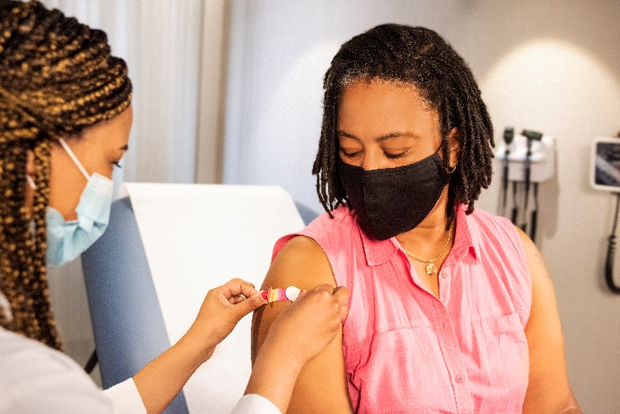
About these COVID-19 mRNA vaccines
These mRNA vaccines are expected to
produce side effects after vaccination,
especially after the 2nd dose.​
Side effects may include: ​
  fever​
  headache​
  muscle aches​
No significant safety concerns were identified in the clinical trials.​
At least 8 weeks of safety data were gathered in the trials. It is unusual for side effects to appear more than 8 weeks after vaccination.
Source: https://www.cdc.gov/vaccines/hcp/acip-recs/vacc-specific/covid-19/clinical-considerations.html
Notes:
So what do we know about these mRNA COVID-19 vaccines? mRNA vaccines are expected to produce symptoms after vaccination, especially after the 2nd dose of vaccination. Side effects may include fever, headache, and muscle aches. These are similar to side effects you may experience after other adult vaccines like the flu vaccine and the shingles vaccine. The clinical trials did not reveal any significant safety concerns. At least 8 weeks of safety data were gathered in the trials, and its unusual for side effects to appear more than 8 weeks post vaccination.
[For the latest information about authorized vaccines, visit the FDA website.]

Slide 10
Fast-tracking COVID-19 vaccines while ensuring safety
Researchers used existing networks to conduct COVID-19 vaccine trials.
Manufacturing began while clinical trials are still underway. Normally, manufacturing doesn’t begin until after completion of the trials.
mRNA vaccines are faster to produce than traditional vaccines.
FDA and CDC are prioritizing review and authorization of COVID-19 vaccines.
*For more information, visit the COVID-19 Prevention Network: www.coronaviruspreventionnetwork.org/about-covpn
Notes:
We realize that you may have concerns about the safety of these first COVID-19 vaccines, because they use new technology. We were able to fast-track these vaccines because researchers used existing clinical trial networks, like those that study HIV treatments and vaccines, to quickly conduct COVID-19 vaccine trials.
Another critical piece has been the investment in manufacturing, even before COVID-19 vaccines have been proven effective. The U.S. government and vaccine manufacturers have invested millions of dollars to scale up vaccine production while clinical trials have been in progress, greatly reducing the amount of time between vaccine authorization and vaccine implementation. Because of the great financial risk, the investment in manufacturing normally doesn’t happen until later in the development process.
As we mentioned earlier, mRNA vaccines are faster and cheaper to produce because they use ready-made materials. And FDA and CDC are working quickly to prioritize review and approval of COVID-19 vaccines.

Slide 11

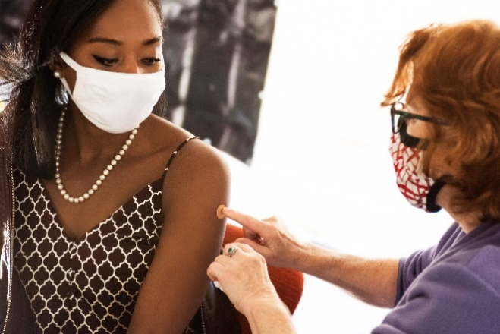
Safety of COVID-19 vaccines is a top priority.
COVID-19 vaccines are being held to the same safety standards as all vaccines.
Before authorization
FDA carefully reviews all safety data from clinical trials.
ACIP reviews all safety data before recommending use.
After vaccine authorization
FDA and CDC closely monitor vaccine safety and side effects.
Notes:
I want to emphasize again that COVID-19 vaccines are being held to the same safety standards as other routine vaccines. Several expert and independent groups evaluate the safety of vaccines being given to people in the United States.
Before ANY vaccines receive authorization or approval, FDA carefully reviews all the safety data from clinical trials. And the Advisory Committee on Immunization Practices, or ACIP, which is an independent body of experts, reviews all safety data before recommending use. FDA and ACIP have qualified scientific and clinical experts with minimal conflicts of interest reviewing all of the data.
After ANY vaccines are authorized and in use, both FDA and CDC continue to monitor the safety of vaccines.
Existing systems have methods that can rapidly detect possible vaccine safety problems. These systems are being scaled up for COVID-19 vaccine introduction to fully meet the needs of the nation. Additional systems and data sources are also being developed to further enhance safety monitoring capabilities.

Slide 12

Monitoring vaccine safety is a regular, ongoing part of vaccine development.
Existing systems and data sources are used to monitor safety of vaccines after they are authorized or licensed, such as:
  Vaccine Adverse Event Reporting System (VAERS)
  Vaccine Safety Datalink (VSD)
  Clinical Immunization Safety Assessment (CISA)
  Biologics Effectiveness and Safety System (BEST)
New systems are being developed to monitor vaccine
safety, such as v-safe:
  Active surveillance that uses text messaging to initiate
  web-based survey monitoring
  Any clinically important events reported by a participant
  would be sent to VAERS for follow-up
Notes:
Monitoring vaccine safety is a regular, ongoing part of vaccine development and these systems have been in place for decades to ensure the safety of routine vaccines. These systems are complementary and work together to monitor vaccine safety. Components include:
VAERS, which collects and analyzes reports of adverse events that happen after vaccination.
The Vaccine Safety Datalink and the Post-Licensure Rapid Immunization Safety Monitoring System, which are networks of healthcare organizations that actively analyze the healthcare information of millions of people; and
The Clinical Immunization Safety Assessment, or CISA, which is a collaboration between CDC and 7 medical research centers. CISA assists healthcare providers with complex vaccine safety questions and conducts clinical research studies to better understand vaccine safety.
FDA’s Biologics Effectiveness and Safety System, or BEST, which is a system of electronic health record, administrative, and claims-based data for active surveillance and research
These existing data systems can rapidly detect signals for possible vaccine safety problems.
Additional systems and data sources are also being developed to further enhance safety monitoring capabilities. One example is v-safe—an active surveillance system that uses text messaging to initiate web-based survey monitoring.
As you can see, no shortcuts on vaccine safety are taken for these COVID-19 vaccines or any other vaccine.

Slide 13

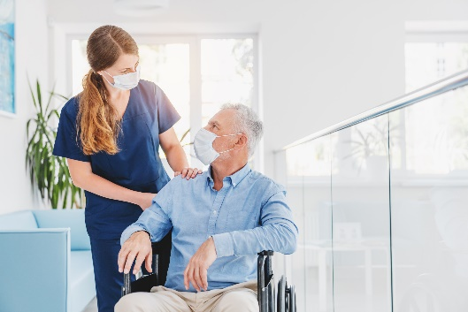

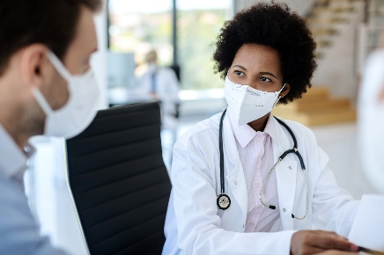
COVID-19 vaccination will help protect you from COVID-19.
Getting a COVID-19 vaccine...
  Will help create an immune response in your body against the virus.
  May help keep you from getting severely ill, even if you do get COVID-19.
Can protect your family, your coworkers, and patients.
Notes:
What are the benefits of getting a COVID-19 vaccine? COVID-19 vaccination will help keep you from getting COVID-19. Getting a COVID-19 vaccine will help create an immune response in your body against the virus without your having to experience illness. Based on what we know about vaccines for other diseases, experts believe that getting a COVID-19 vaccine may help keep you from getting seriously ill even if you do get COVID-19.
Getting vaccinated yourself may also protect people around you--your family, your coworkers, patients--particularly people at increased risk for becoming severely ill from COVID-19.

Slide 14
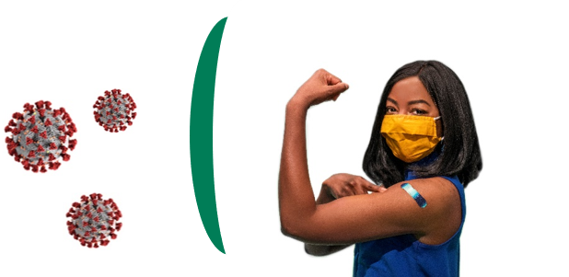
COVID-19 vaccination is a safer way to build protection.
Getting the virus that causes COVID-19 may offer some natural protection, known as immunity. But experts don’t know how long this protection lasts.
The risk of severe illness and death from COVID-19 far outweighs any benefits of natural immunity.
COVID-19 vaccination will help protect you by creating an antibody response without the risk of severe illness.
Notes:
COVID-19 vaccination will also be a safer way to help build protection. Getting the virus that causes COVID-19 may offer some natural protection, known as immunity. But experts don’t know how long this protection lasts, and the risk of severe illness and death from COVID-19 far outweighs any benefits of natural immunity. COVID-19 vaccination will help protect you by creating an antibody response.

Slide 15
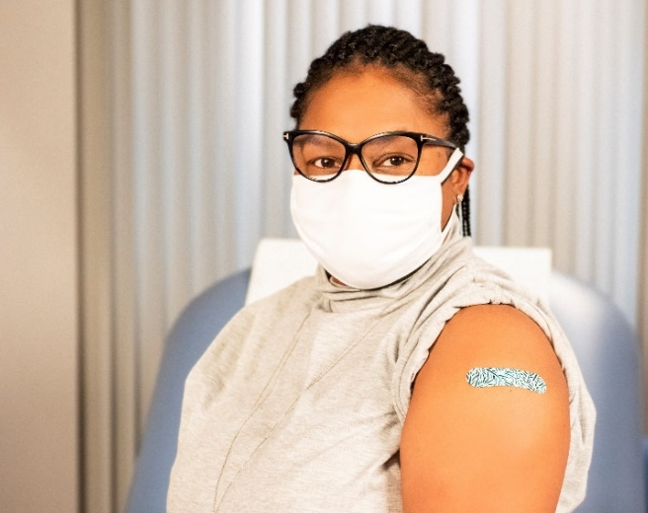
Vaccination is one measure to help stop the pandemic.
While COVID-19 mRNA vaccines appear to be highly effective, additional preventive tools remain important to limit the spread of COVID-19.
The combination of getting vaccinated and following CDC recommendations to protect yourself and others offers the best protection from COVID-19.
  Cover your nose and mouth with a mask.
  Avoid close contact. Maintain social distancing.
  Clean and disinfect.
  Wash your hands.
Notes:
COVID-19 vaccination will be an important tool to help stop the pandemic, but it continues to be one tool in the toolbox. While COVID-19 mRNA vaccines appear to be highly effective, additional preventive tools remain important to limit the spread of COVID-19. The combination of getting vaccinated and following CDC’s recommendations to protect yourself and others will offer the best protection from COVID-19. Wash your hands. Avoid close contact. Cover your nose and mouth with a mask. Clean and disinfect frequently touched surfaces. Stopping a pandemic requires using all the tools we have available.
It will take time to vaccinate all Americans. While the vaccines are being delivered, it's important that everyone continue to take all steps to prevent spread of COVID-19.

Slide 16
The facts:
COVID-19 mRNA vaccines will not give you COVID-19.
None of the COVID-19 vaccines in use or under development use the live virus that causes COVID-19.
People can experience normal side effects, such as fever, after vaccination. These side effects are signs that the body is building immunity.
It takes a few weeks for the body to build immunity after vaccination. A person could be infected with the virus that causes COVID-19 just before or just after vaccination and get sick. This is because the vaccine has not had enough time to provide protection.
Notes:
As COVID-19 vaccine becomes more widely available, you may hear more information and misinformation from your friends, family, social media, and peers. Accurate information is key, so we want to review some key facts.
COVID-19 mRNA vaccines will not give you COVID-19. As we’ve mentioned, none of the COVID-19 vaccines currently in use or under development in the United States use the live virus that causes COVID-19. People can experience side effects, such as fever, after receiving the vaccine, especially after the 2nd dose. This is because the first shot primes the immune system, helping it recognize the virus, and the second shot strengthens the immune response. These side effects are normal and are signs that the body is building immunity. It also typically takes a few weeks for the body to build immunity after vaccination. That means it’s possible a person could be infected with the virus that causes COVID-19 just before or just after vaccination and get sick. This is because the vaccine has not had enough time to provide protection.

Slide 17
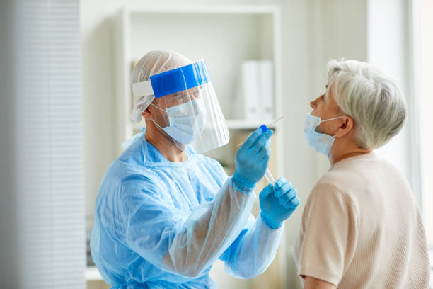
The facts:
COVID-19 mRNA vaccines will not cause you to test positive on COVID-19 viral tests.
Vaccines currently authorized for use or in development won’t cause you to test positive on viral tests, which are used to see if you have a current infection.
There is a possibility you may test positive on some antibody tests, which show previous infection. This would indicate that the vaccine likely triggered an immune response in your body and that you may have some level of protection against the virus.
Notes:
Another fact: COVID-19 mRNA vaccines will not cause you to test positive on COVID-19 viral tests. Vaccines currently authorized or in clinical trials in the United States won’t cause you to test positive on viral tests, which are used to see if you have a current infection. If your body develops an immune response, which is the goal of vaccination, there is a possibility you may test positive on some antibody tests. Antibody tests indicate you had a previous infection and that you may have some level of protection against the virus.

Slide 18
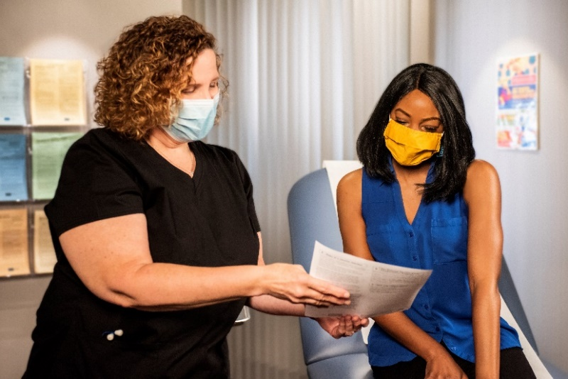
The facts:
People who have gotten sick with SARS-CoV-2, the virus that causes COVID-19, may still benefit from vaccination.
People may be advised to get a COVID-19 vaccine even if they have already had the virus. This is because a person can become infected with the virus more than once.
At this time, experts do not know how long someone is protected from getting sick again after recovering.
Notes:
People who have gotten sick with the virus that causes COVID-19 or a severe COVID infection may still benefit from getting vaccinated. People may be advised to get a COVID-19 vaccine even if they have already had the virus. This is because a person can catch the virus more than once.
At this time, experts do not know how long someone is protected from getting sick again after recovering from COVID-19. The immunity someone gains from having an infection, called “natural immunity,” varies from person to person.
Experts are working quickly to learn more about COVID-19 vaccines, and CDC will keep the public informed as new evidence becomes available.

Slide 19
What to expect before, during, and after COVID-19 vaccination
Before
  Learn about COVID-19 vaccines.
  See if COVID-19 vaccination is recommended for you.
During
  Read the fact sheet that tells you about the specific COVID-19 vaccine you receive.
  Receive a vaccination record card.
After
  With most COVID-19 vaccines, you will need two shots.
  Expect some side effects.
  Enroll in v-safe.
  Continue using all the measures to protect yourself.
Notes:
Now that we’ve covered what we know about COVID-19 mRNA vaccines, the benefits of vaccination, and clarified the facts, you may have questions about what to expect before, during, and after your vaccination appointment. Before vaccination, you should learn more about the different types of COVID-19 vaccines and how they work. We’ve provided some of this information for you today. And you should see if COVID-19 vaccination is recommended for you right now.
During your vaccination appointment, you should receive a paper or electronic version of a fact sheet specific to the COVID-19 vaccine you are being offered that contains information to help you understand the risks and benefits of receiving that specific vaccine. After you are vaccinated you should be given a vaccination record card that tells you what COVID-19 vaccine you received, the date you received it, and where you received it.
As we mentioned previously, with most COVID-19 vaccines, you will need two shots in order for them to work. Be aware that side effects are expected, especially after the 2nd dose. They include fever, headache, and muscle pain or body aches. You should get the second shot even if you have side effects after the first one, unless a vaccination provider or your doctor tells you not to get a second shot. Side effects are a sign that the vaccine is working to protect you.
Your provider may also give you information about how to enroll in v-safe. As we mentioned earlier, v-safe is a free, smartphone-based tool that uses text messaging and web surveys to provide personalized health check-ins after you receive a COVID-19 vaccination. This program will help CDC monitor safety of COVID-19 vaccines. And finally, its important to remember that we don’t currently know how much protection COVID-19 vaccines will provide under real-world conditions. You should continue using all the tools available to help stop this pandemic. Cover your mouth and nose with a mask when you are around others, stay at least 6 feet away from others, avoid crowds, and wash your hands often.

Slide 20
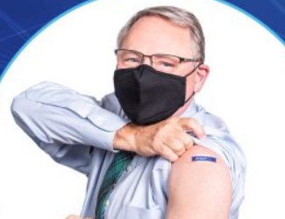
Protect yourself, your family, friends, coworkers, patients, and community. Get vaccinated.
Choose to get vaccinated yourself when it is available to you.
Participate in v-safe and help CDC monitor for any health effects after vaccination.
Share your experience with coworkers, friends, and family.
Know the basics about the COVID-19 vaccine.
Help answer questions from your family
and friends.
Visibly show you received a vaccine, such as
by wearing a sticker or button.
Notes:
COVID-19 vaccination can protect you, your family, your friends, your coworkers, patients, and your community. Choose to get vaccinated when it is available to you. Participate in v-safe and help CDC monitor for any health effects after vaccination. Share your experience with your coworkers, friends, and family. And visibly show that you received a vaccine, such as by wearing a sticker or button. You have a role in increasing confidence in COVID-19 vaccination, and sharing your experience may influence those you care about.

Slide 21
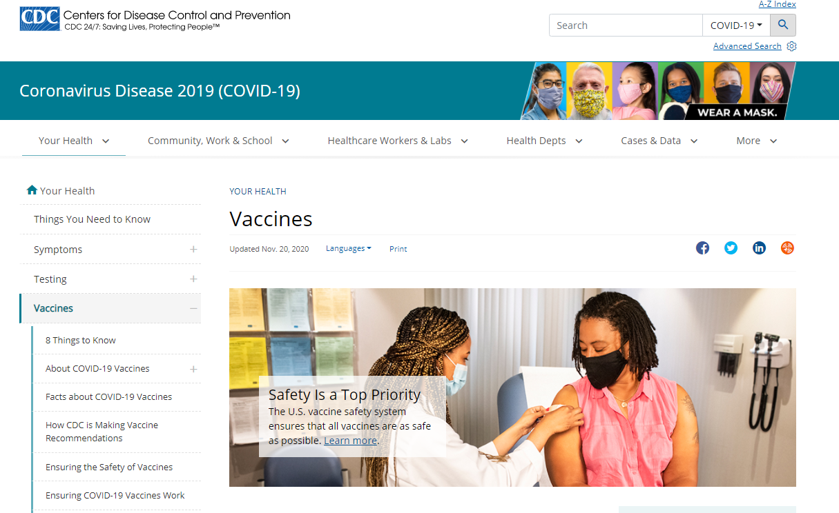
Learn more!
https://www.cdc.gov/coronavirus/2019-ncov/vaccines/index.html
Notes:
CDC has a wealth of information as well as links to additional resources on the CDC website. You can find more information at the URL listed on this slide.
Stopping this pandemic is going to take all our tools. Building vaccine confidence is a critical strategy to increase uptake and it requires a team effort. Thank you for helping to make this happen!

