Slide 1
Our Lady of Prompt Succor Nursing Facility
This was presentation was created
to help educate our residents and
family members on our infection
control program and ways you all
can help with implementing
the program.

Slide 2
Infection Control Programs are an important program especially in nursing home related to the population which are extremely vulnerable and prone to illness due to age, immune systems, and chronic conditions. Our top priority is ensuring the safety and well being of our residents, staff, and visitors.

Slide 3
Hand Hygiene
The number one way to prevent the spread of infection!
Can reduce respiratory illness like colds by 21% and can reduce
Diarrheal illness in people with weakened immune systems by 58%.
Use Soap & Water when:
Visibly dirty hands
After using the restroom
After caring for a person with known or suspected diarrhea or norovirus.
Be sure to use soap and lather for 20 seconds.
Hand Sanitizier:
Dispense enough to cover every surface. Rub until dry.

Slide 4
Remember to wash your hands and encourage your loved ones to wash their hands.

Slide 6
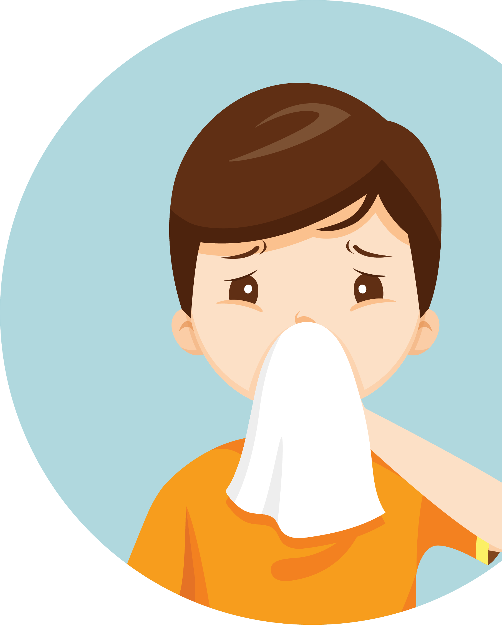
Please cover your cough and sneezes to help prevent the spread of respiratory infections. Don’t forget to perform hand hygiene.
Respiratory Etiquette and Hygiene

Slide 7
Please wear a mask when you are ill or when it is required in the facility related to a recent outbreak of an illness.

Slide 8
Coronavirus Health and Safety Tips
Wash your hands often
Use hand sanitizer
Wear a mask
Don’t touch your face
Cover your sneezes and coughs
Avoid close contact
Use your own supplies
Clean your electronics

Slide 9
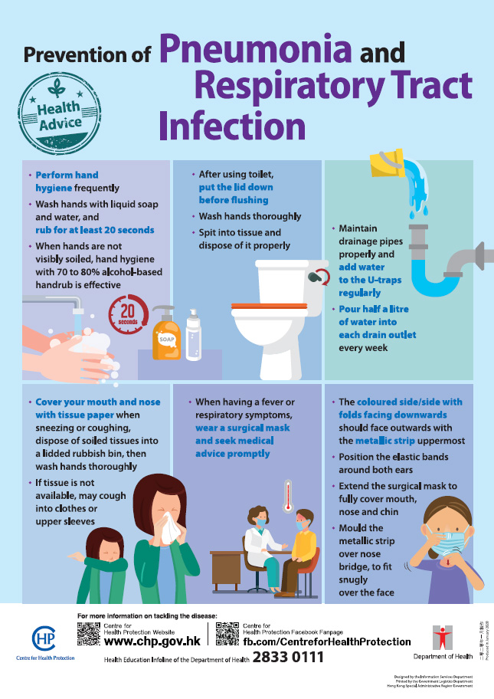

Slide 10
Types of Precautions
Contact Precautions are required to protect against either direct or indirect transmission
Contact-Droplet Precautions to protect against COVID-19 virus
Standard Precautions applies to all patient care regardless of suspected or confirmed infection status in any setting.
Enhanced Barrier Precautions designed to reduce transmission of MDROs in nursing homes.
Droplet Precautions are required to protect against droplets from nasal mucosa, conjunctivae, or mouth that travel no more than 3 feet from the resident.
Airborne Precautions required to protect against airborne transmission of infectious agents. Residents who require airborne precautions are transferred to another location.
When a resident is on Contact, Contact-Droplet, or Droplet Precautions,
always check with the nurse first before entering a room.

Slide 11
ANTIBIOTIC STEWARDSHIP PROGRAM

Slide 12
Improving Antibiotic Use

Slide 13
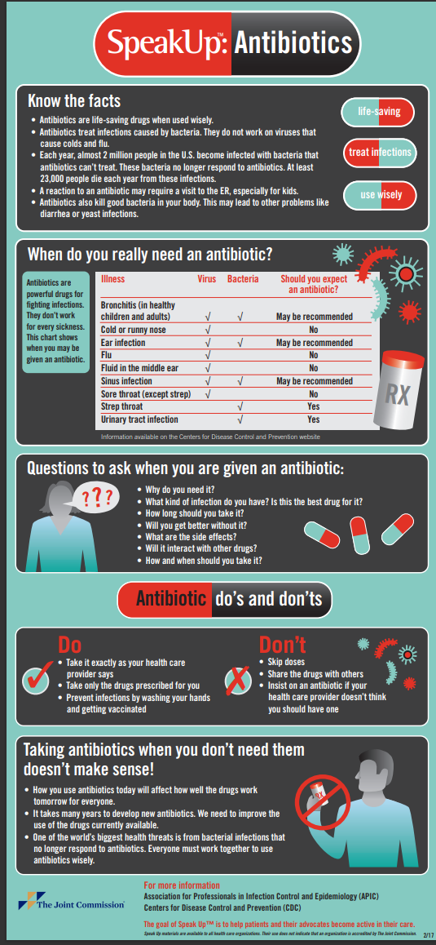

Slide 20
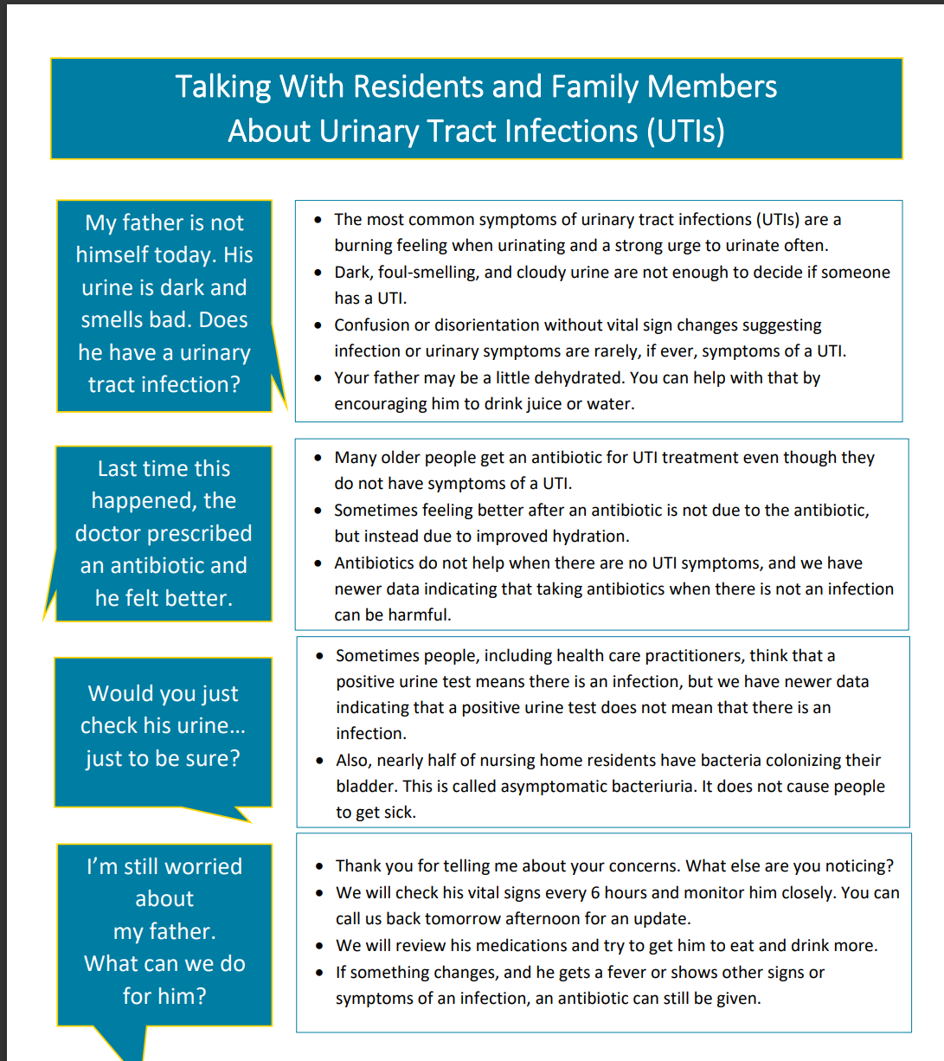

Slide 21
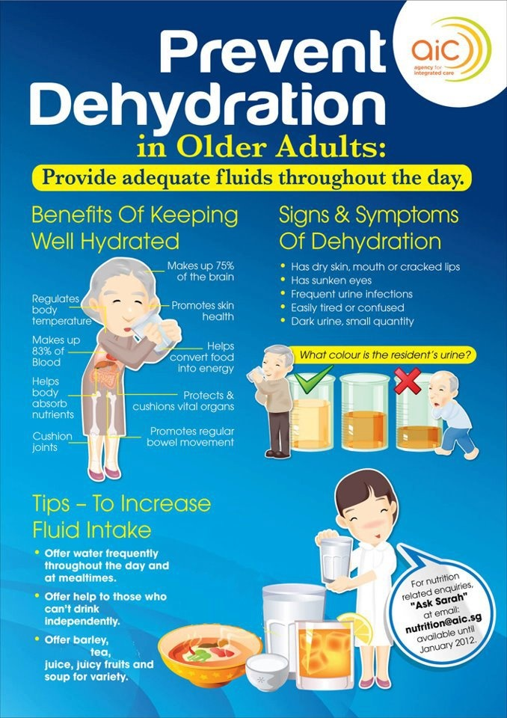
Encourage residents to hydrate themselves,
If they do not like and are refusing to drink
water. Allow them to drink anything they like,
something is better than nothing. Inform
a Supervisor or Nurse of what they do like
so we can ensure their pitcher in their room
is filled with what they do like.
Encourage them to change their incontinent
pads more often. A lot of residents refuse to
change them related to waste or putting that
burden on their families to buy more.
Encourage them to urinate at least every two
hours and when needed. Explain to them
about completely emptying their bladder
each time.
Encourage them to cleanse front to back.
never back to front.
Encourage good hand hygiene before and
after toileting. Before meals and activities.
When returning from therapy.

Slide 22
VACCINEs
Play a vital role in preventing the spread of infectious diseases and reducing the severity of illness.

Slide 24
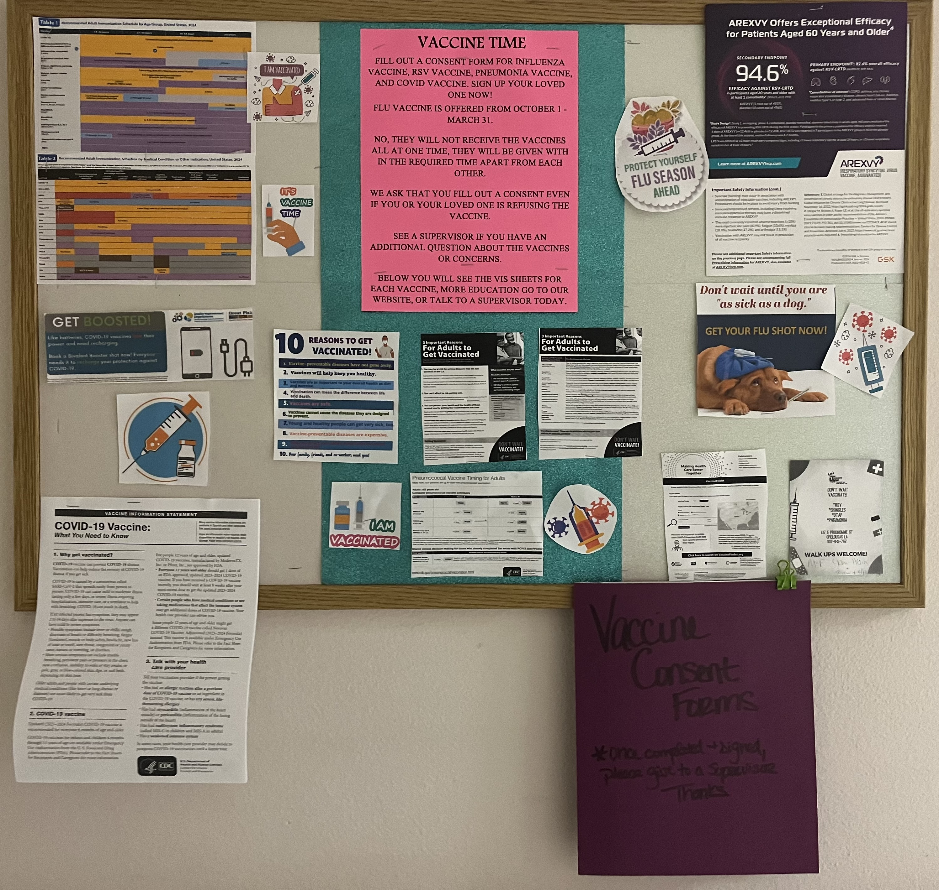
Located down Holy Family
Hallway,
Our Vaccine Board
for more education
and you can even pick up
a consent form
to fill out. Please
return to a Supervisor
or our receptionist, Laqueta.
Thanks.

Slide 25
For more information press ctrl and click on the link below:
https://www.cdc.gov/coronavirus/2019-ncov/vaccines/stay-up-to-date.html
https://d.docs.live.net/f3a6910bcbaff5cd/Desktop/RCG-Fact-Shet-6mos-through-11YOA_11SEPT23-Moderna-COVID-19-Vaccine-(2023-2024)%20.pdf
FACT SHEET FOR RECIPIENTS AND CAREGIVERS ABOUT PFIZER-BIONTECH COVID-19 VACCINE (2023-2024 FORMULA) WHICH HAS EMERGENCY USE AUTHORIZATION (EUA) TO PREVENT CORONAVIRUS DISEASE 2019 (COVID-19) IN INDIVIDUALS 6 MONTHS THROUGH 11 YEARS OF AGE (fda.gov)

Slide 26
Influenza Vaccine
Only Offered October 1 – March 31

Slide 27
RSV
Vaccine

Slide 29
Pneumonia Vaccine

Slide 30
Td and Tdap Vaccine

Slide 31
Zoster
(Shingles)
Vaccine

Slide 32
Vaccine Consent Forms
Please fill out a vaccine consent form and return at your earliest convenience. Even if it a refusal to the vaccines, please fill out and return. Thanks.
At any time, you or your loved one's has changed his/her mind about receiving a vaccine, you can always fill out another consent form. Just keep in mind about the Flu Vaccine it is only offered
October 1 – March 31.

Slide 33
We thank you all for watching our presentation and we hope it was very helpful in providing insight and education on how everyone can work together. If you have any question or concerns, please do not hesitate to give me a call, Brittany Brown, RN Infection Preventionist/MDS Coordinator
@ 337-948-3634 Ext: 232. Again, thank you for your time.
We appreciate you all for allowing us
to care for your loved ones.

